Slide 1
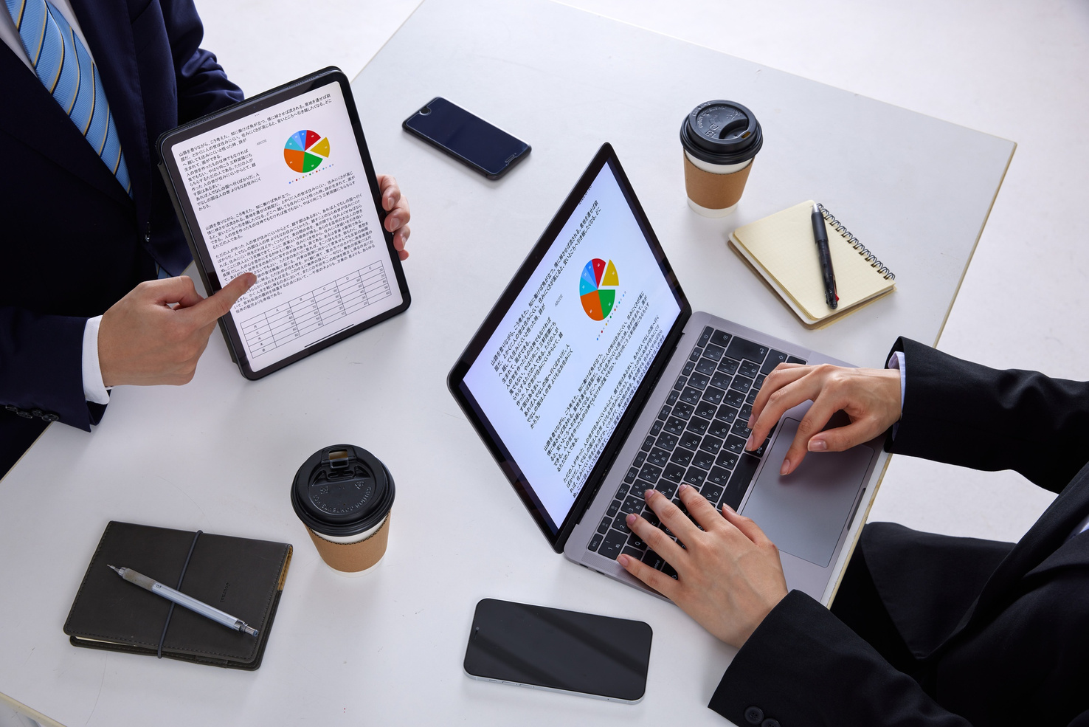



Rimberio
www.reallygreatsite.com
TelEcoM Customer Churn Prediction
Presented By:
Pollob Sikder

Slide 2
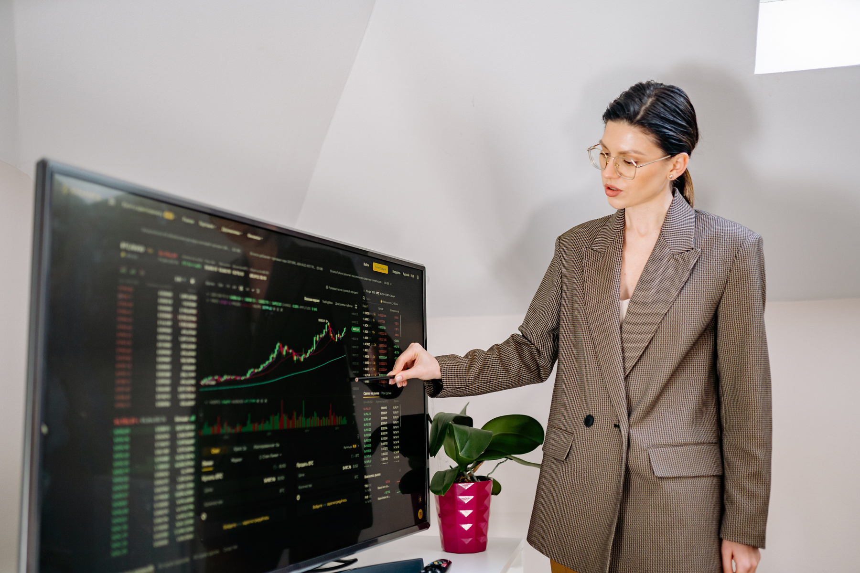

Technologies Used:
Python
Pandas
Scikit-learn
Streamlit
Matplotlib
Seaborn
@reallygreatsite

Slide 3

Objectives
Predict customer churn using machine learning
Accuracy Test By using Different ML Models
Select The Best Model For Churn Prediction
Build a Apps to Predict Customer Churn

Slide 4
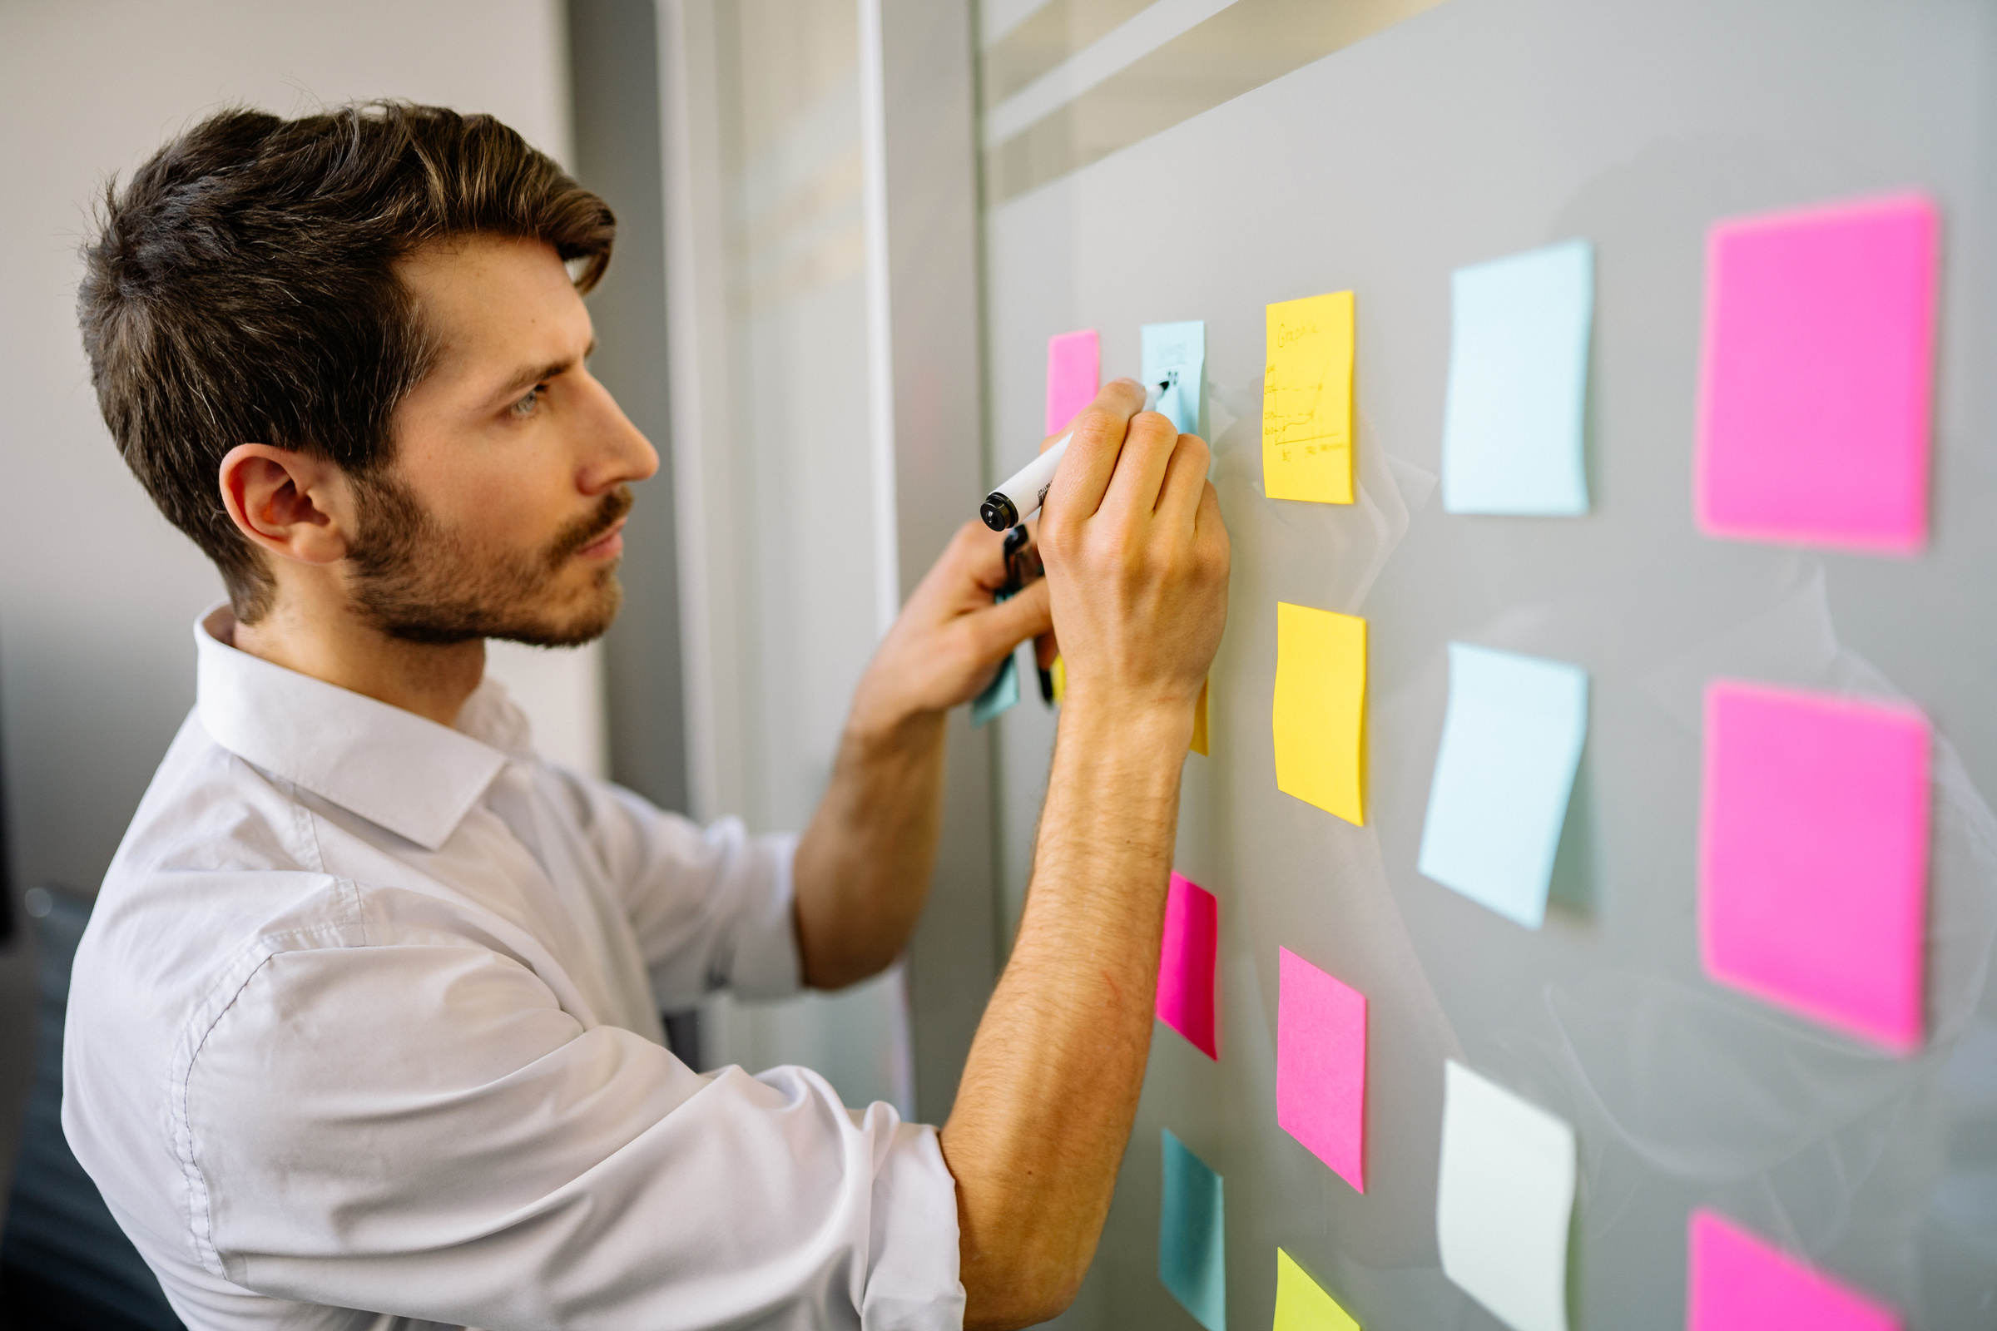
Limitations
Due to time limitations, the business and financial aspects of customer churn were not explored in detail.
Only three machine learning models were tested and compared during this project.
The project focused mainly on technical implementation and model development.
Further improvements could be achieved by using larger datasets and advanced machine learning algorithms
Understanding customer behavior enables the company to deliver relevant solutions, improve engagement, and strengthen relationships

Slide 5
Thank You
Questions & Answers
By Pollob Sikder
Github: https://github.com/Sikder369/ML_Telecom_Customer_Churn.git

